Slide 1
Section 4.2 What are Rates? Unit rates

Slide 2
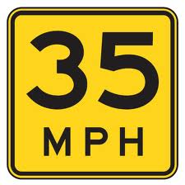
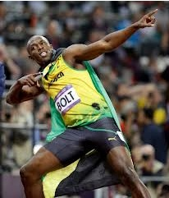
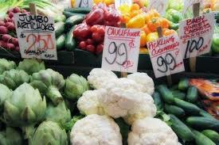
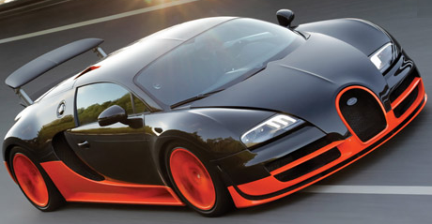
I) What are Rates:
A comparison of two quantities measured in “different” units
Ie: Speed: meters per second, km/hour, miles/hour
Fastest man on earth 29km/hr
Fastest car in the world v2 457km/hr
Speed of a bullet 2000km/hr
Speed of light 300,000km/s
Wages and Salaries
MacDonalds: $8.25/hr
Accountant (CGA): $50/hr
Doctor: $200/hr
Cost
Groceries
Corn: 3 corn/$1

Slide 3
II) Unit Rates
When finding unit rates, the second quantity has a unit of “one”
Useful for comparing prices and rates
Divide both values by the number in the denominator
RATE:
Conversion RATE (Unit Rate)
$1.00 / 3 corn
Divide $1 by 3
$0.33 / 1 corn
200m / 20seconds
Divide 200m by 20
10m / 1 second
25 clicks in 30 seconds
Divide 25m by 30
0.8333 clicks / 1 second

Slide 4
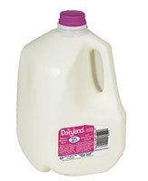
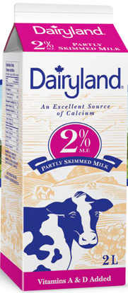
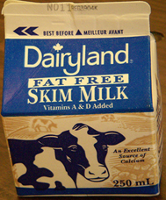
Ex: Tom went to Costco, Safeway, and Superstore to buy milk. He got the following prices for each product. What is the unit rate for each one? Which one should he buy?
Costco
Safeway
Superstore
Unit Price:
Unit Price:
Unit Price:
The $5.59/4L at Costco is the best buy

Slide 5
III) Comparing Unit Price
Learning how to find unit pricing will help you save money
Once you have two items priced out per unit you can properly compare which one is cheaper
Ex: If peanut butter is sold at $6.99 for a 1.5 kg jar and at $2.50 for a 200 g jar which is the better buy?
1st Option
2nd Option
The 1st option is cheaper (Buy in bulk)
© Copyright all rights reserved to Homework depot: www.BCMath.ca

Slide 6
Practice: Which is a better deal? 5 CD’s for $12.99 or 1 CD for $2.99? Use unit pricing.
1st Option
This is cheaper than buying 1 cd at a time
Practice: A store sells juice at $0.99 for 355 mL and $1.19 for 500 mL, which is the better buy?
1st Option
2nd Option
The 2nd option is cheaper (Buy in bulk)
© Copyright all rights reserved to Homework depot: www.BCMath.ca

Slide 7
IV) Speed, Time, and Distance (STD):
Some questions on rates involve Speed, Time, and Distance
Ex: If Ivon can run 250m in 20seconds and Yolanda can run 4 km in 5min, who can run faster?
Ivon’s Speed:
Yolanda’s Speed:
Yolanda’s runs faster!!

Slide 8
Practice: Usain Bolt can run 100m in 9.58seconds. What is his speed in meters per seconds?
Practice: The speed of light is 300,000 km/s. If the distance between the sun and earth is 150,000,000km, then how long does it take light to travel from the sun to the earth?
That’s about 8.33 minutes

Slide 9
Challenge: Mr Y and Mr. X are racing each other around a 30km track three times. Mr. Y can drive at 120km/hr and Mr. X can drive at 100km/hr. Who will finish the race first and by how much time?
Find the total distance travelled
Y
X
Y
X
Find the time for each driver
To find the time, divide
the distance by the speed
Finish
Convert the time to minutes and then subtract them to get the difference

Slide 10
https://youtu.be/3nbjhpcZ9_g

